Slide 1
Exploratory Data Analysis
Submitted by : Pramod Kulkarni
November Batch (BDS)

Slide 2
ED Analysis :
Exploratory Data Analysis (EDA) is the process of
visualizing and analyzing data to extract insights from
it. In other words , EDA is the process of summarizing
important characteristics of data in order to again better
understanding of the dataset .

Slide 3
Descriptive Statistics Analysis
Handling missing values in dataset
Correlation

Slide 4
Descriptive statistics analysis :
Descriptive statistics analysis helps to describe the basic features of dataset and obtain a brief summary of the data .
The describe() method in pandas library helps us to have a brief
summary of the dataset .

Slide 5
ED Analysis :
Exploratory Data Analysis (EDA) is the process of visualizing and analyzing data to extract insights from it .

Slide 6
Box Plot :
Another way of analyzing numerical data would be to use box plots. Box plot shows us the median of the data , which represents where the middle data point is.

Slide 7
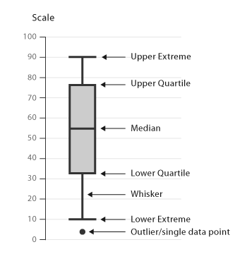
1) Box Plot

Slide 8
2. Scatter Plots
Scatter plot represent each relationship between two
continuous variables as individual data point in a 2D
graph.
We will use the scatter() method of matplotlib library
to visualize the scatter plot.

Slide 9
3) Histograms
Histograms shows us the frequency distribution of a
variable.
Statement:
Histograms is a graphical representation that a group of data points into user-specified ranges call as Histogram.

Slide 10
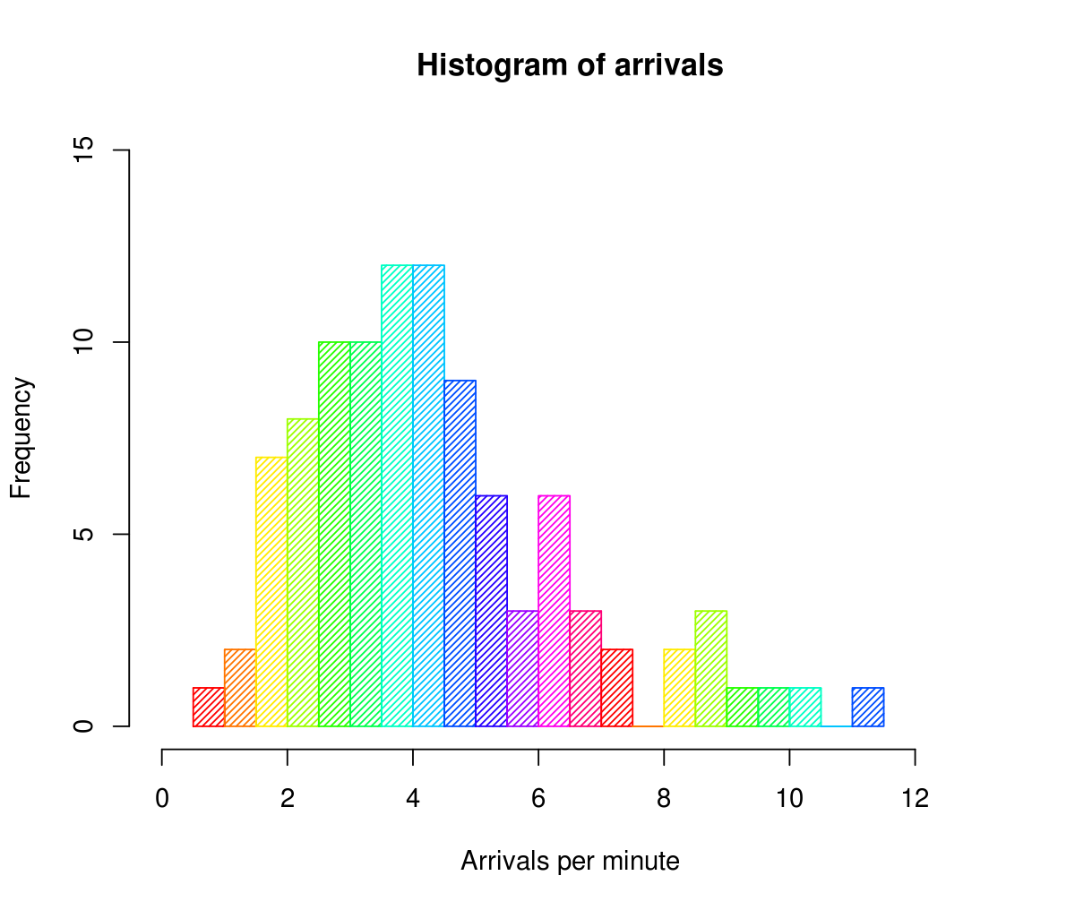

Slide 11
Heat Map
This is a great way to get visual clues about the data .
We will generate a heatmap of the output of isnull() in order to detect missing values .
Statement:
A heat map is two-dimensional visual representation of data using colors, where the colors all represent different
values .

Slide 12
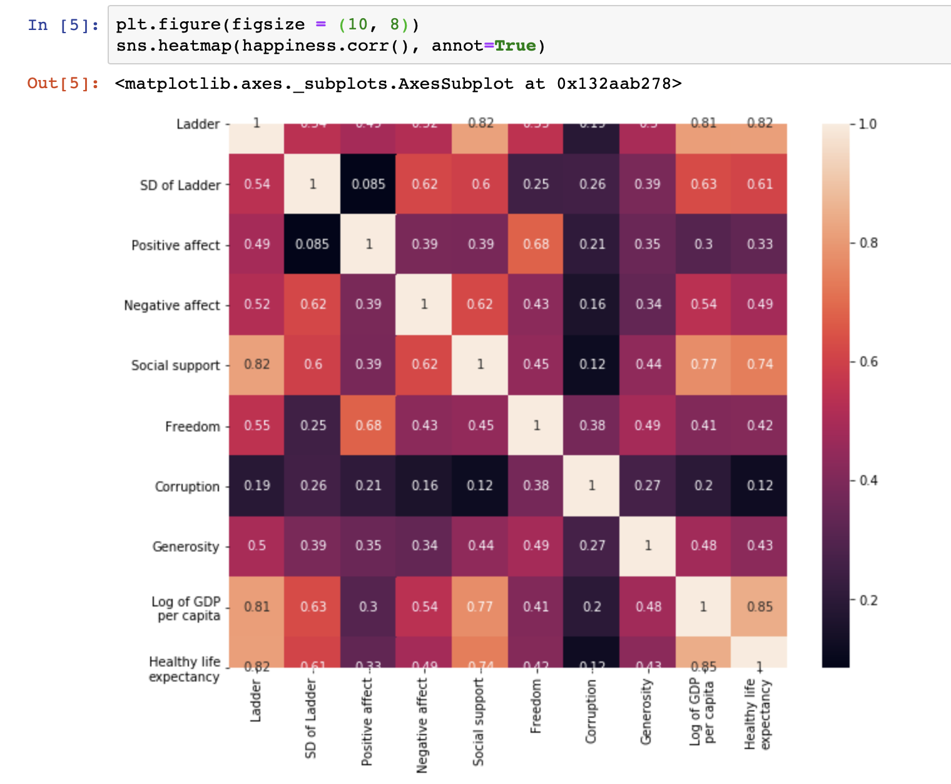
Heat Map
This Photo by Unknown Author is licensed under CC BY-SA

Slide 13
We can handle missing values in many ways:
Delete : dropna()
Impute: fillna()

Slide 14
Correlation
Correlation is a statistical metric for measuring to what extent different variables are interdependent
We can see the correlation between different variables using the corr() function.
Correlation shows the strength of a relationship between two variables and is expressed numerically by the correlation coefficient .The correlation coefficient’s values range between -1.0 and 1.0 .

Slide 15
Relationship between the number of hours a student studies and the score obtained by that student.
Because we expect the student who studies more to obtain higher marks in the exam .

